Slide 1



Garbage Dumping Reminder System

Slide 2
PART 01
Introduction

Slide 3
Goal of this system
Imaging that you went to a tourist attraction, there are full of people, and they have generated a lot of garbage. At that time you want to throw away your garbage, but then you find that all the garbage cans within this area are full, and because the distance between two garbage cans are very far, it can also take the cleaners a lot of time to dump all the garbage cans.
In order to avoid this situation and help the cleaners be able to dump the garbage can in time, we decided to design a reminder system to inform the users when the garbage can needs to be dumped.

Slide 4
Overall design
01
Install our device to the garbage can
Garbage Dumping Reminder System
02
Raspberry Pi collects and stores data
03
Server analyses data and shows these data to users

Slide 5
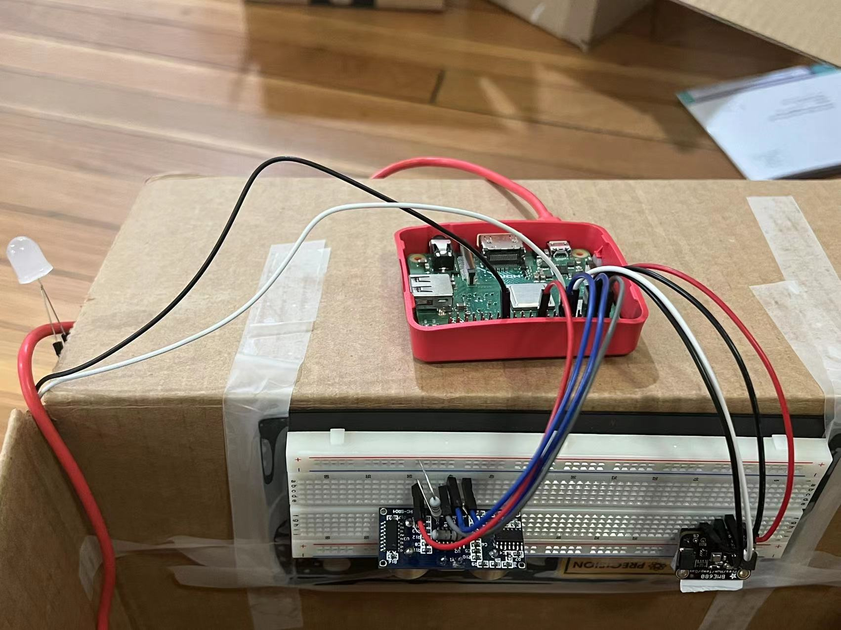
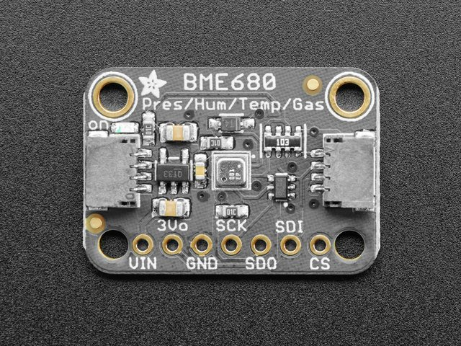
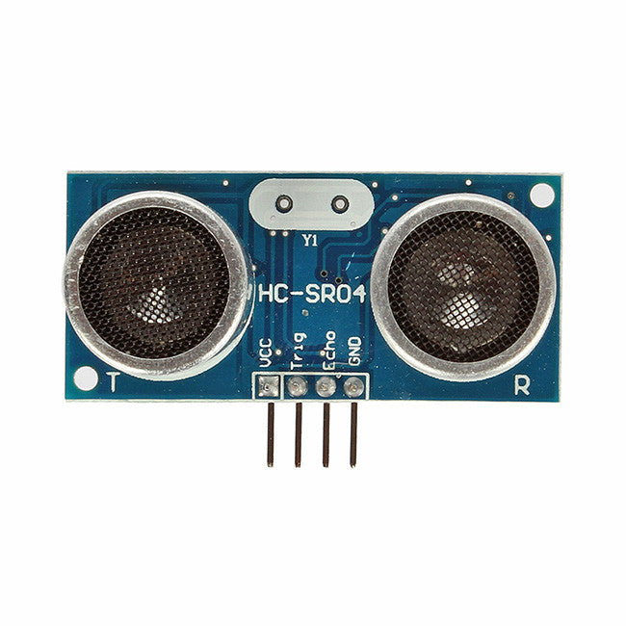
Sensor placement
Infrared sensor (HC-SR04)
Gas Sensor (BME680)
Connection

Slide 6
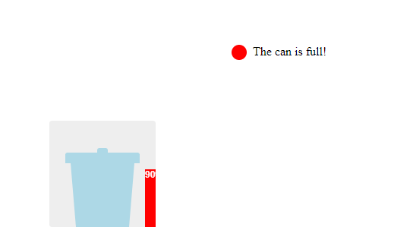
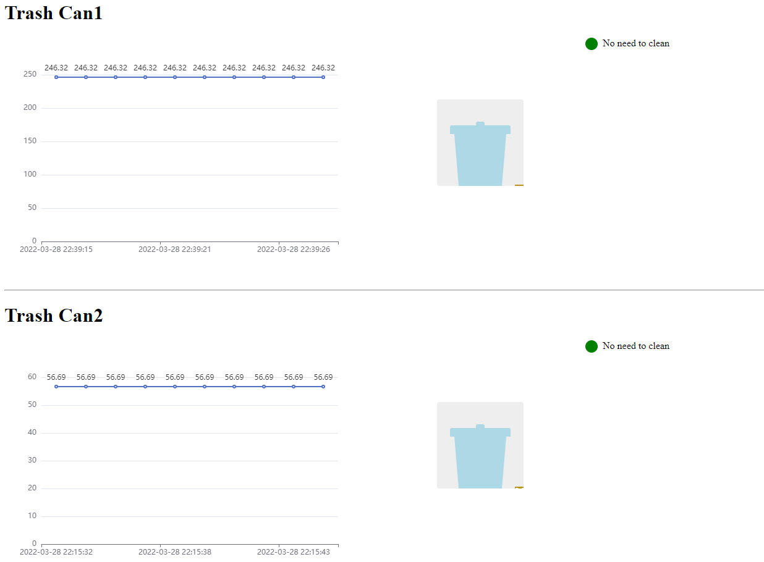
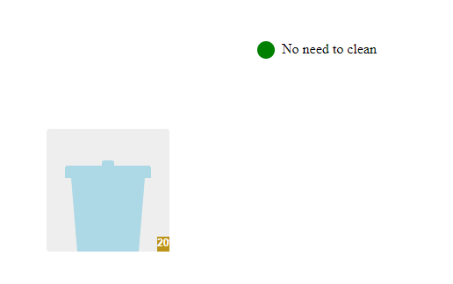
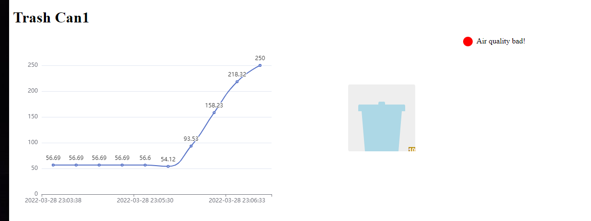
Data Visualization

Slide 7
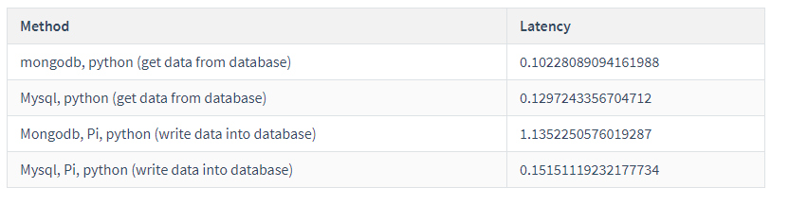
Latency Time

Slide 8
PART 02
Machine Learning for IAQ

Slide 9
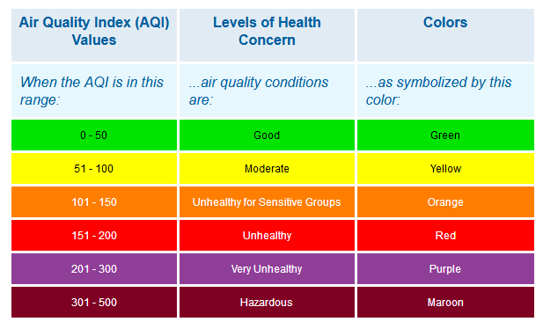
IAQ
The air quality within and around buildings and structures, especially as it relates to the health and comfort of building occupants.

Slide 10
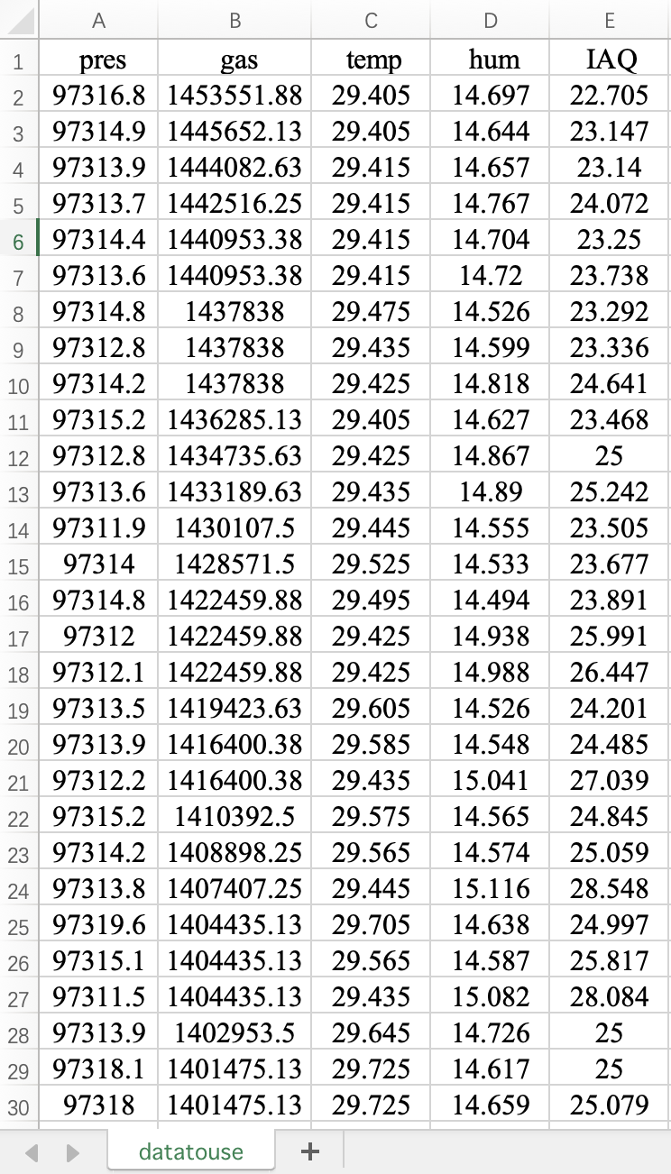
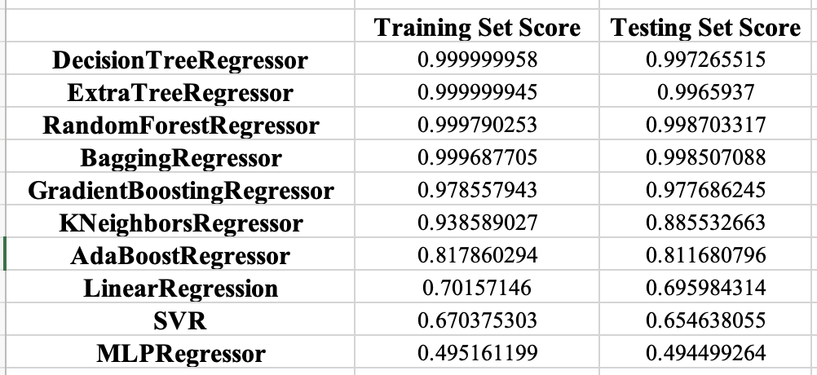
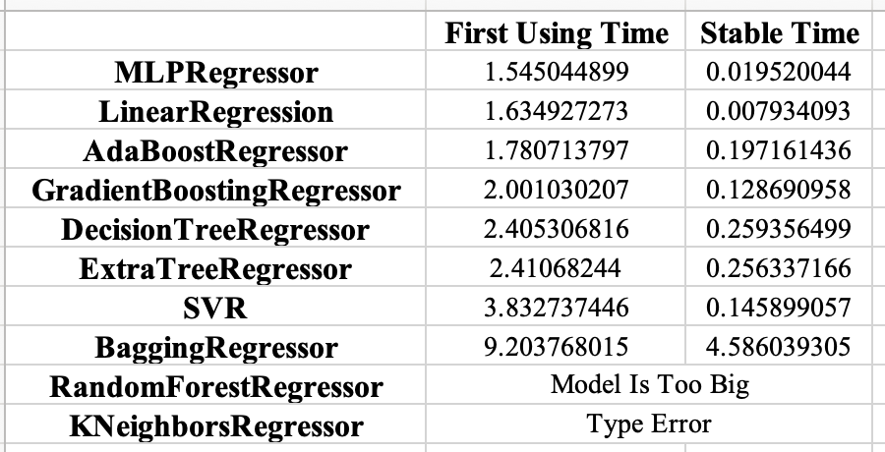
Model Fitting

Slide 11
PART 03
Demo Video

Slide 12
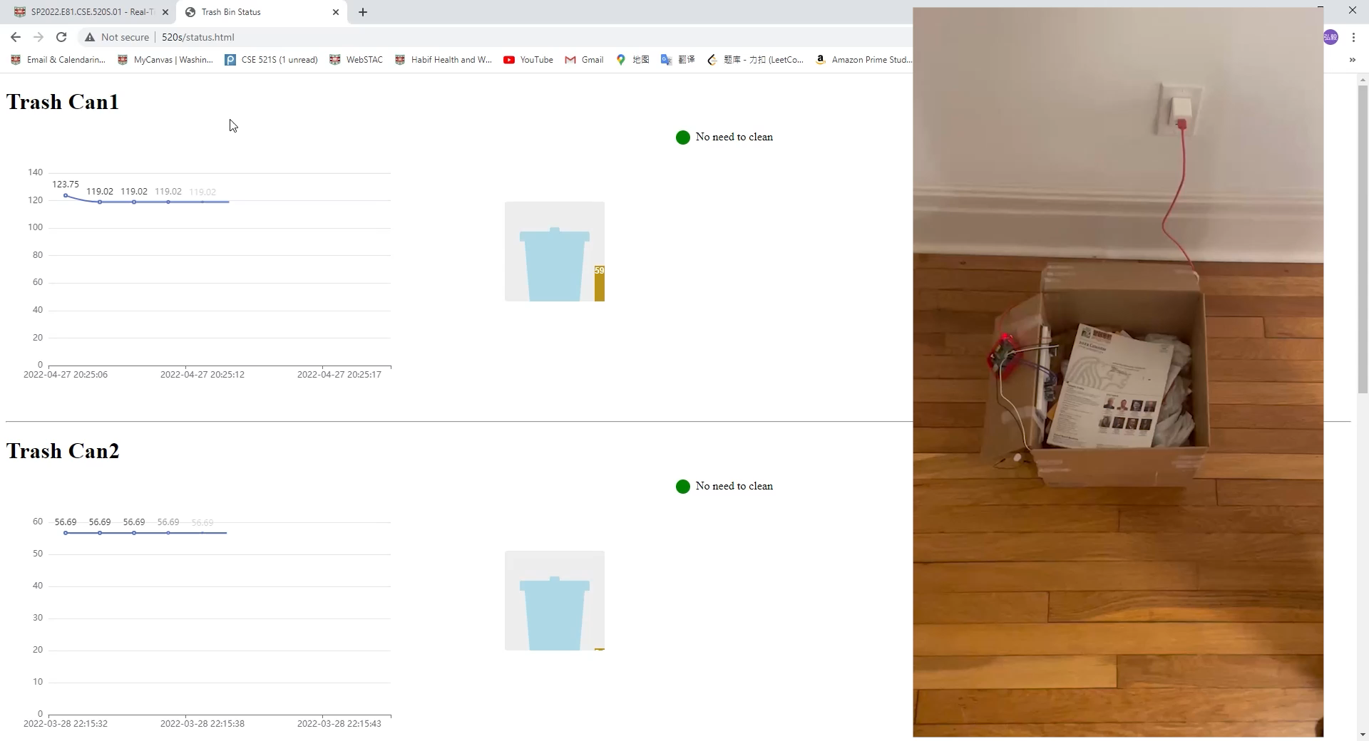
Height Test

Slide 13
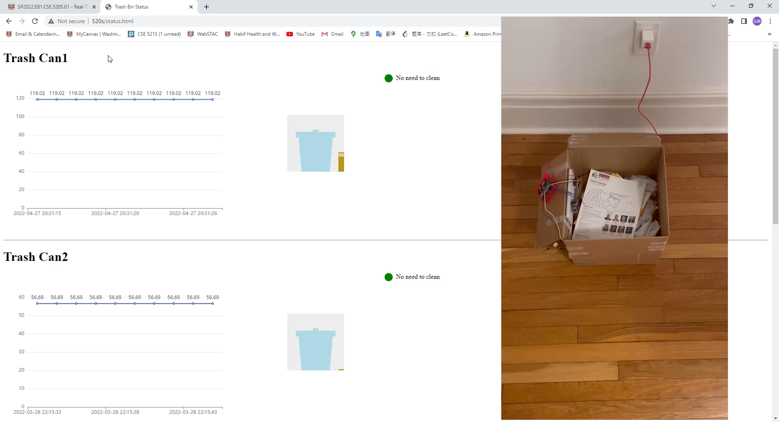
Air Quality Test

Slide 14
Future Work
Improve the visual effect of the website
Do some work to support multiple trash can state track

